Slide 1
Capstone
Gage Hockerman
GageHockerman (c) 2023
Notes:
Add A footer lower left with a CopyRight on it GageHockerman (c) 2023 //Smaller font Capstone //Slide x of y //All repeating Header //

Slide 2
Table of Contents
What is Data Analysis
Problem Definition
Data Acquisition/Data Exploration
Data Cleansing and Preparation
Model Development and Analysis
GageHockerman (c) 2023

Slide 3
What is Data Analysis
Identify the problem
Define the problem
Collect data
Analyze the data
Find a solution
GageHockerman (c) 2023
Notes:
Don’t Put Definition of Data Analysis, Only Put Pointers

Slide 4
Problem Definition
Goal of identifying the problem problem
Find correlation between data
Simple/Complex data
GageHockerman (c) 2023

Slide 5
Data Acquisition/Data Exploration
Collect and combine the appropriate data
Qualitative/Quantitative data
GageHockerman (c) 2023

Slide 6
Data Cleansing and Preparation
Remove errors and outliers
Bringing structure
Fill in major gaps
GageHockerman (c) 2023

Slide 7
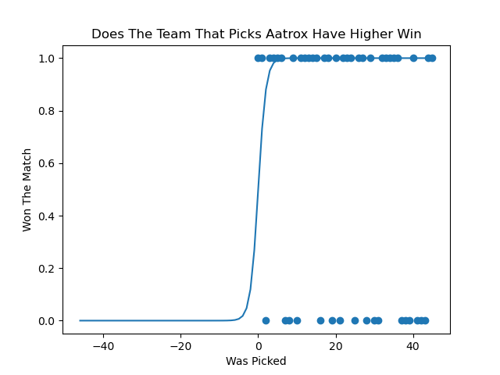
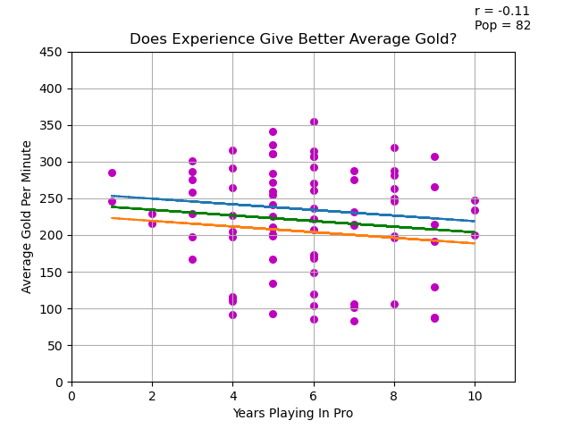
Model Development and Analysis
Linear Regression
Logistic Regression
GageHockerman (c) 2023
Notes:
Talk about the first problem in some sentences //

Slide 8
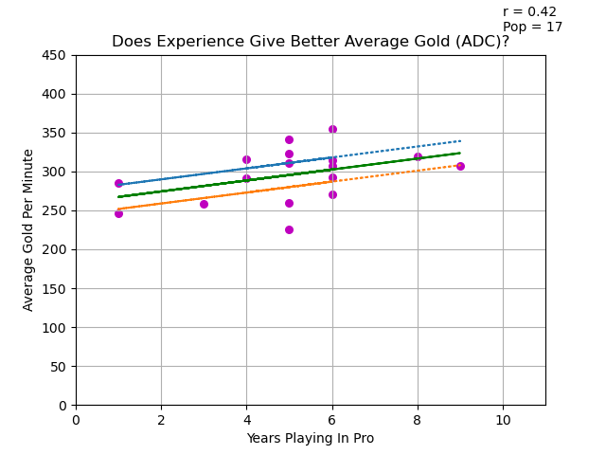
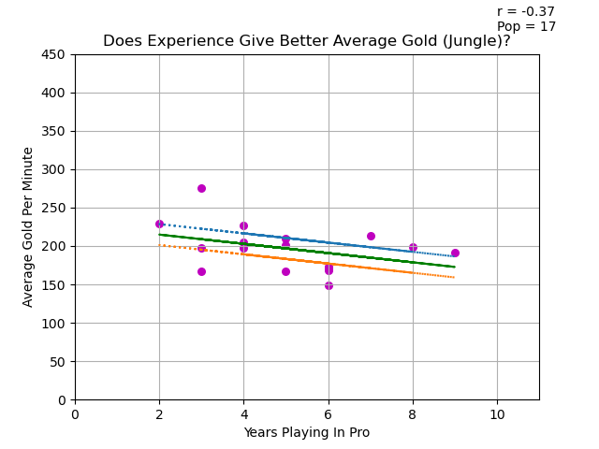
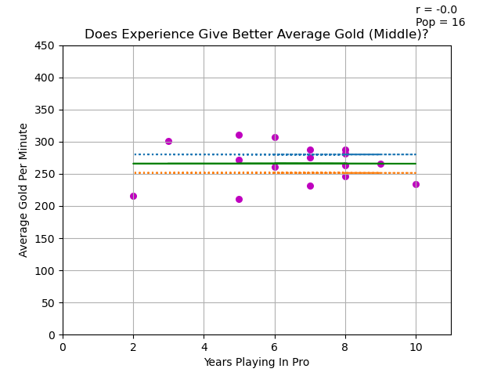
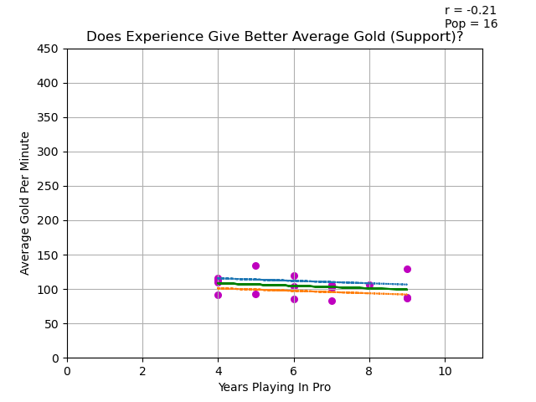
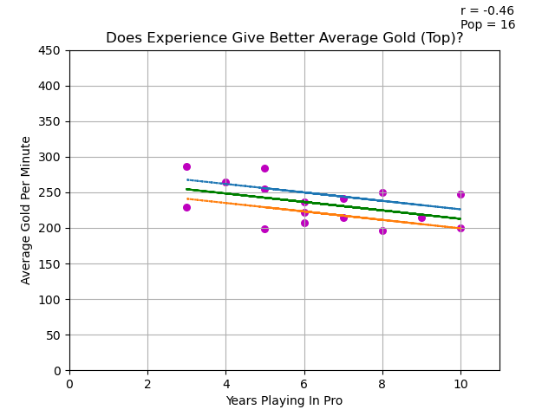
Same Data Broken Out By Role
GageHockerman (c) 2023
Notes:
Look into Facet out a data set in matplotlib

Slide 9
Conclusion
Thank you for the learning experience!!!
GageHockerman (c) 2023

Slide 10
Thank You!
Please Feel Free to Contact Me
Email : bishopcastle@gmail.com
P# 262-402-7481
GageHockerman (c) 2023

